Slide 1

Reviewer
Final Presentation
Your go-to guide for everything local - REVIEWER!
Team 4
Sanjeev Kumar
Nayan Yadav
Bisheng Zeng
Kaushal Dobbariya
Vaibhav Babbariya
Prasad Menda
Vignan Kasam
Sai Kiran Bokkola

Slide 2
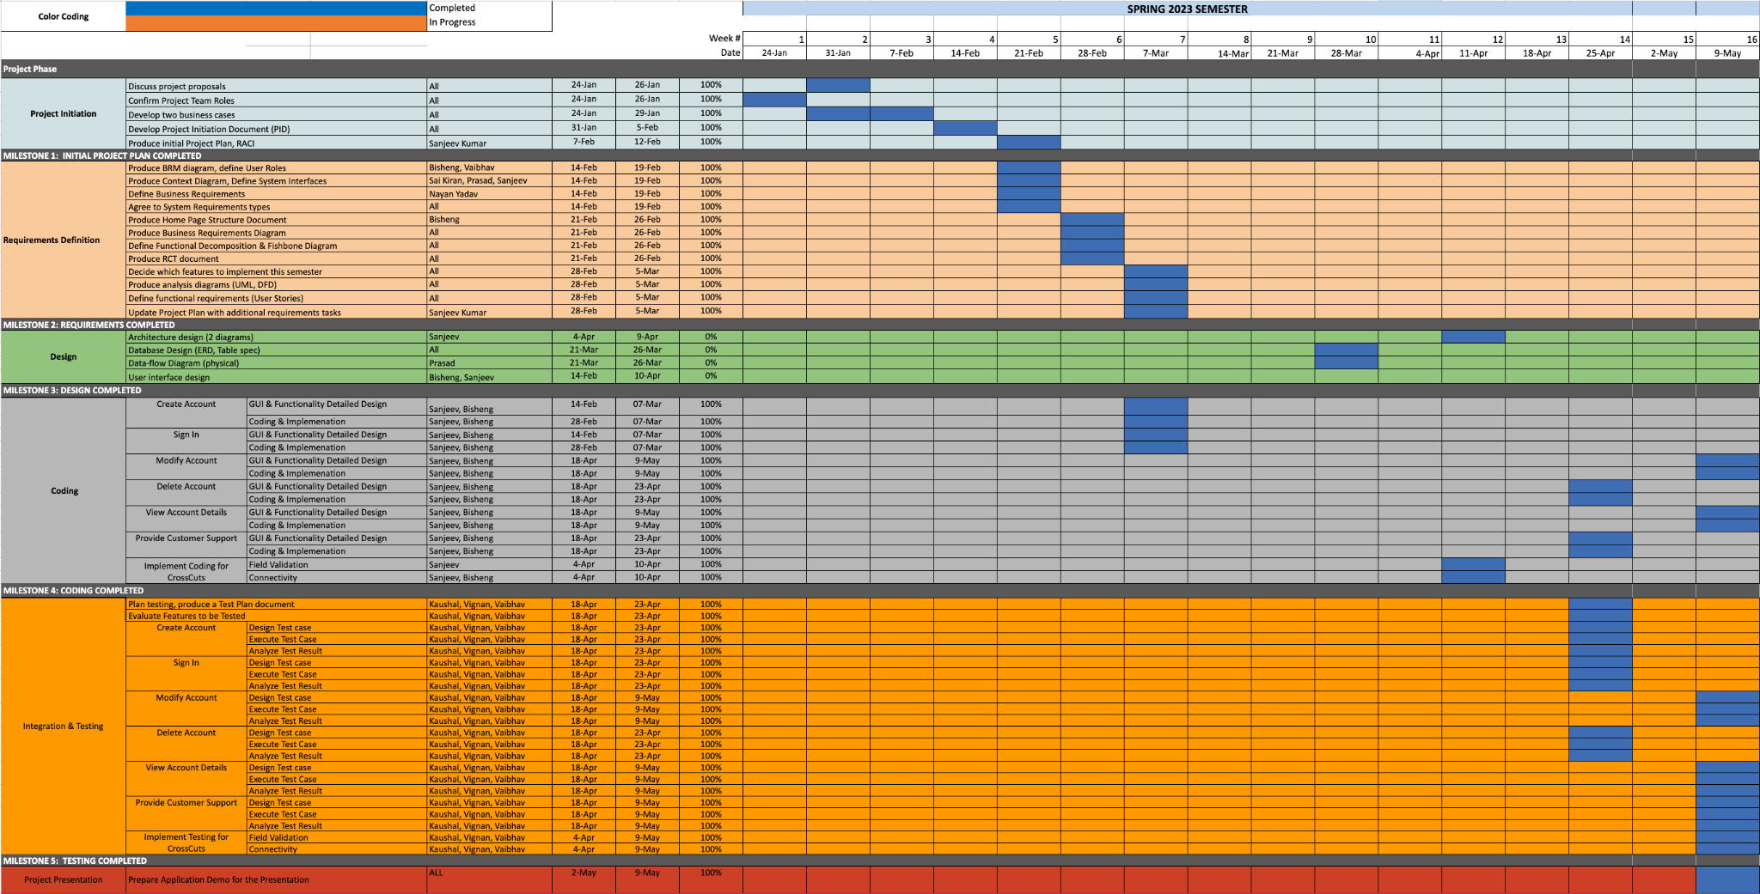
Project Plan
https://github.com/sanjeev-khannan/Reviewer/blob/main/Project%20Documents/Team4_ProjectPlan_v14.xlsx

Slide 3
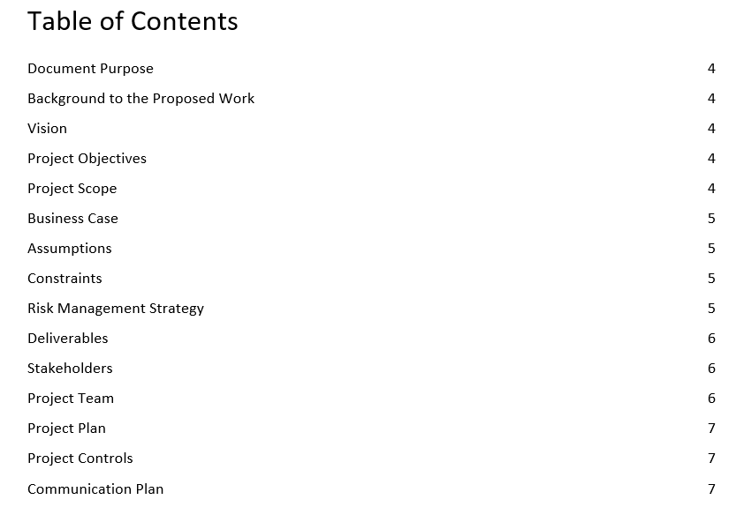
PID DOCUMENT
https://github.com/sanjeev-khannan/Reviewer/blob/main/Project%20Documents/Team4_ProjectInitiationDocument_v3.docx

Slide 4
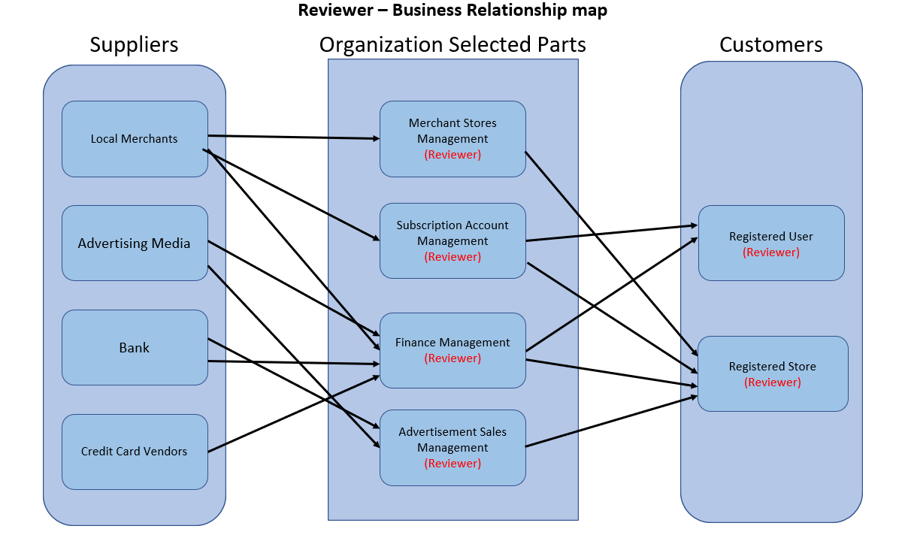
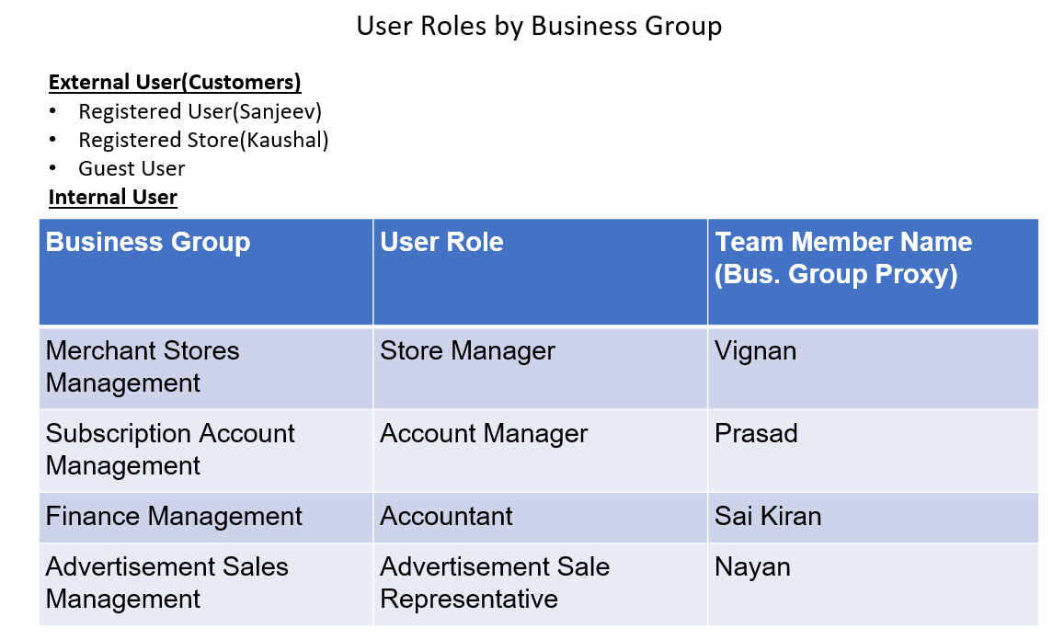
BRM DIAGRAM, USER ROLES - Bisheng
https://github.com/sanjeev-khannan/Reviewer/blob/main/Project%20Documents/Team4_BRMDiagram_v4.pptx

Slide 5
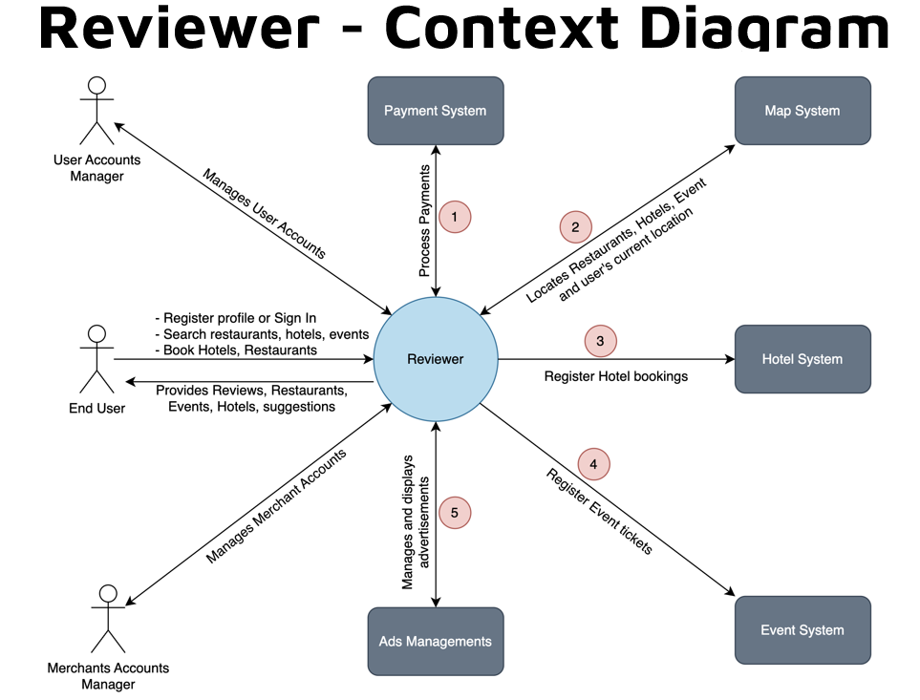
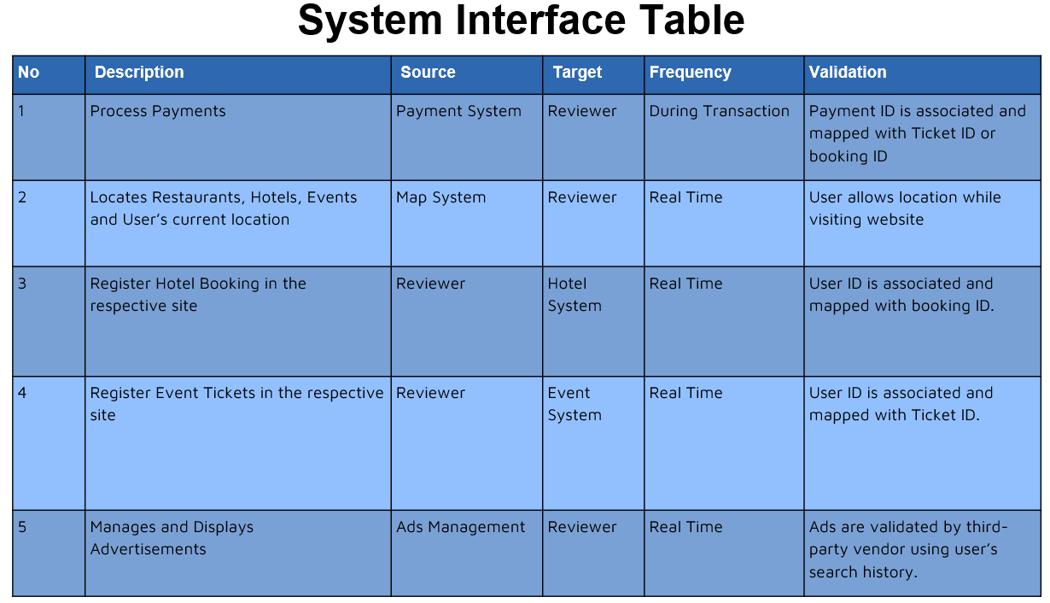
CONTEXT DIAGRAM - Sai Kiran
https://github.com/sanjeev-khannan/Reviewer/blob/main/Project%20Documents/Team4_ContextDiagram_v3.pptx

Slide 6
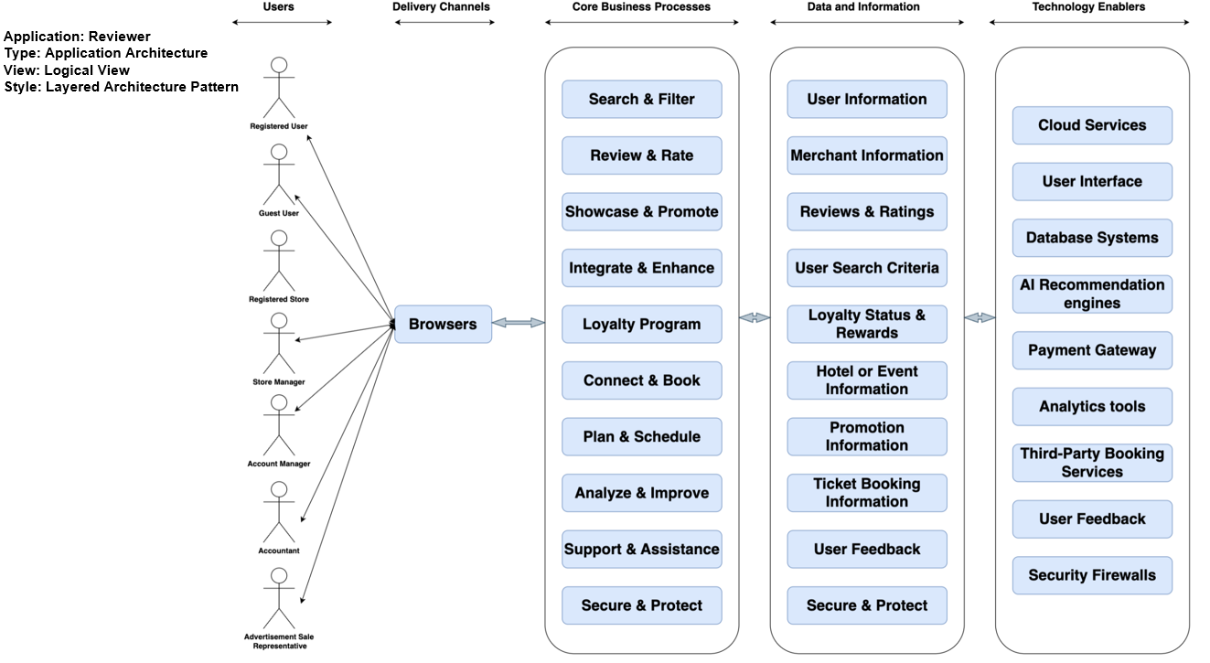
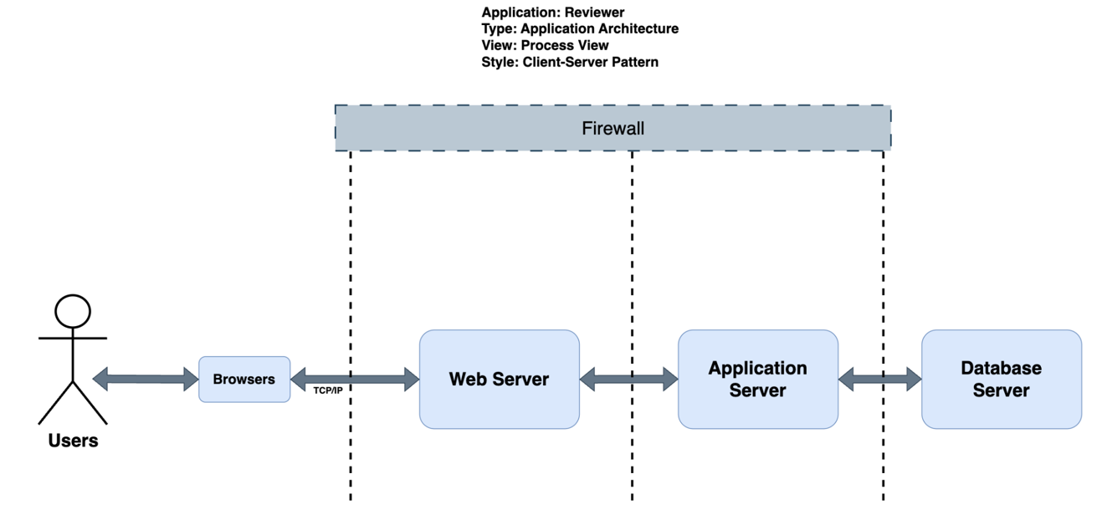
ARCHITECTURE DIAGRAM - Bisheng
https://github.com/sanjeev-khannan/Reviewer/blob/main/Project%20Documents/Team4_ArchitectureDiagram_v1.pptx

Slide 7
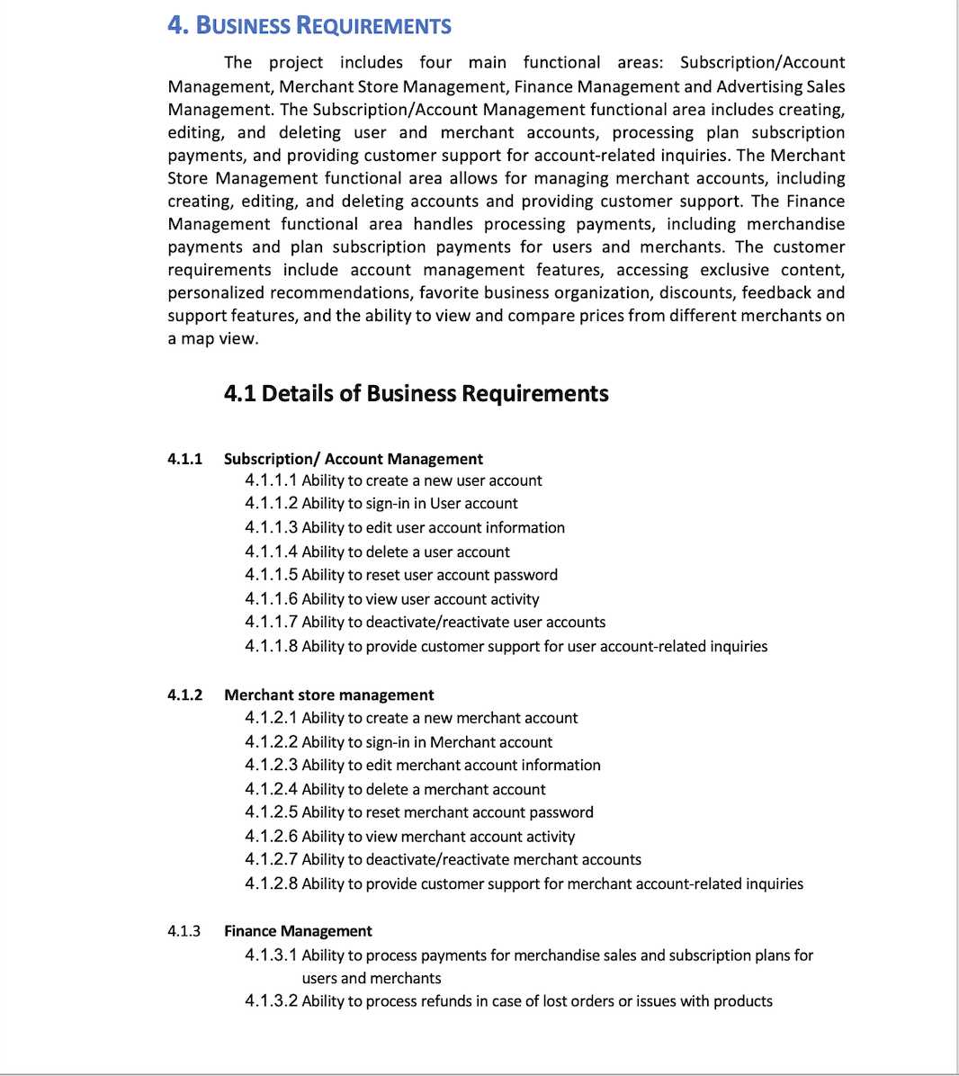
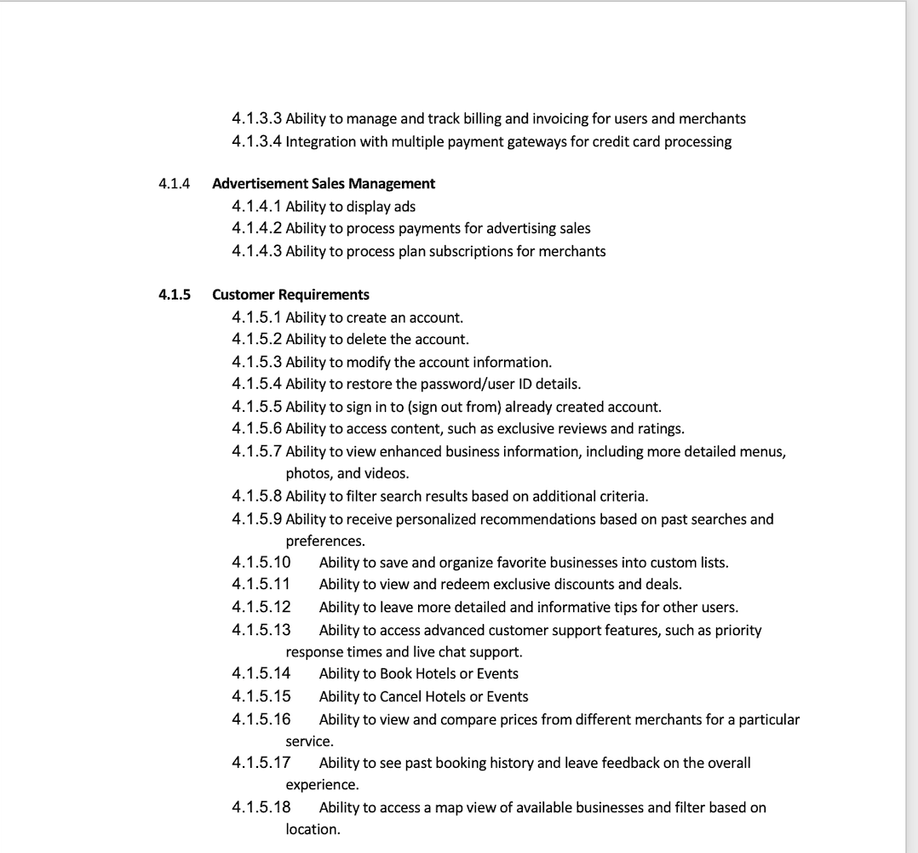
Business Requirements - Sanjeev
https://github.com/sanjeev-khannan/Reviewer/blob/main/Project%20Documents/Team4_BusinessRequirements_v3.docx

Slide 8
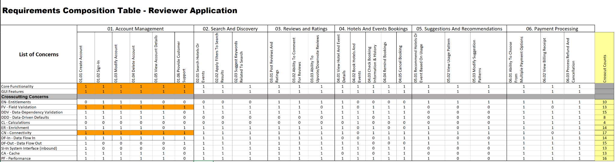
RCT - Kaushal
https://github.com/sanjeev-khannan/Reviewer/blob/main/Project%20Documents/Team4_RCT_v8.xlsx

Slide 9
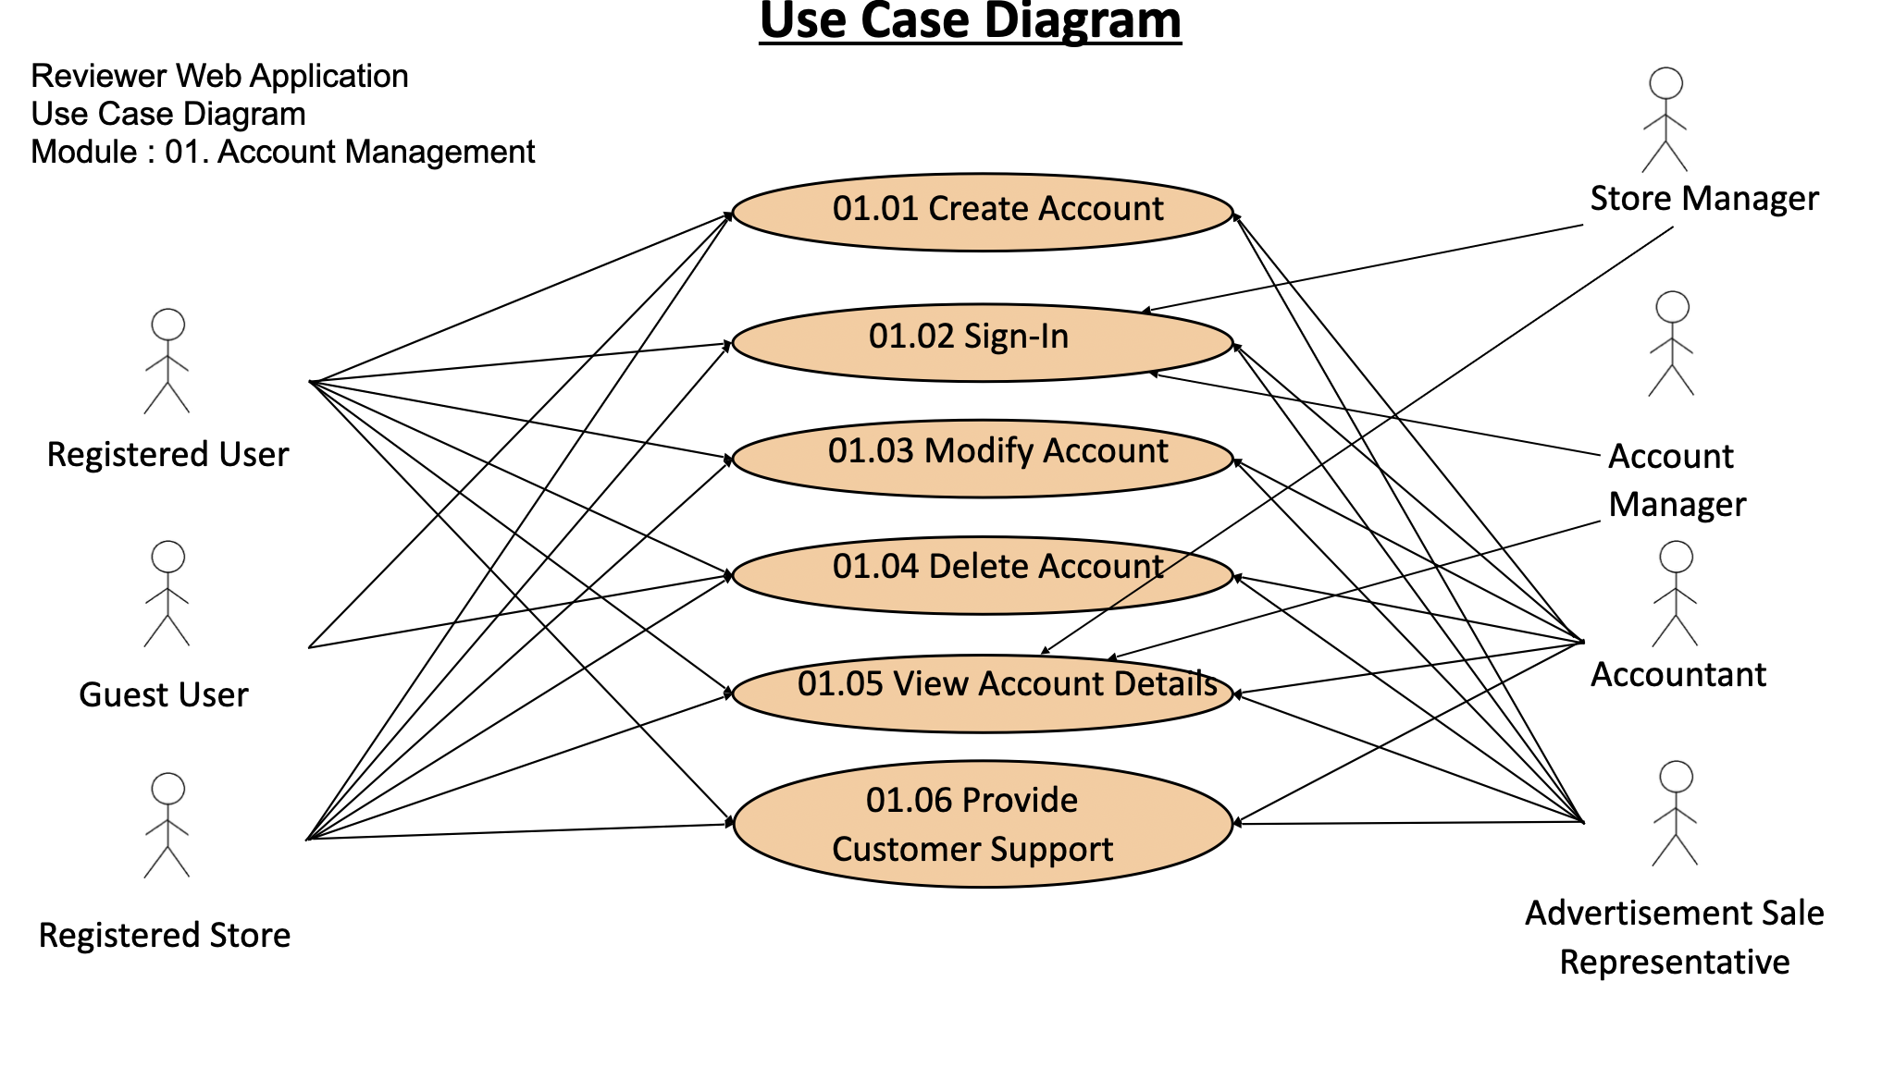
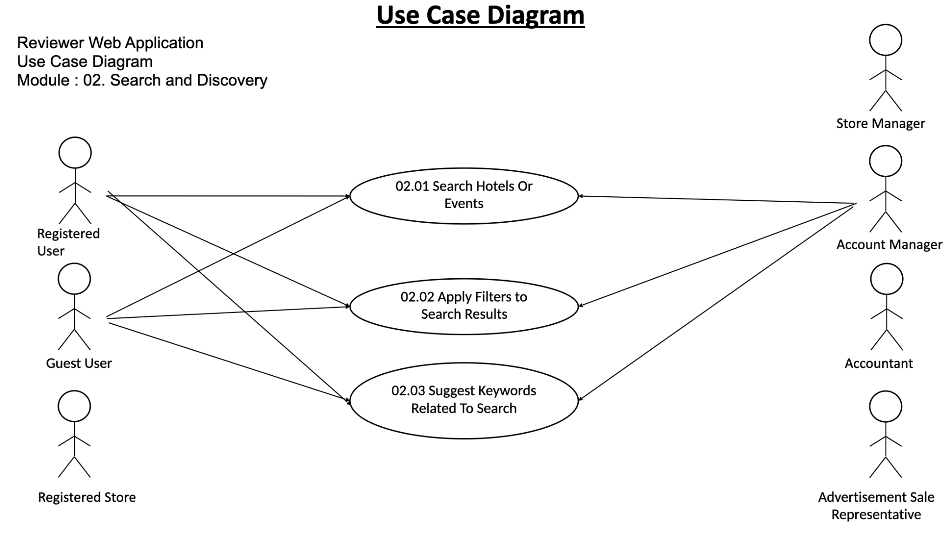
Use Case Diagram - Vaibhav
https://github.com/sanjeev-khannan/Reviewer/blob/main/Project%20Documents/Team4_UseCaseDiagram_v2.pptx

Slide 10
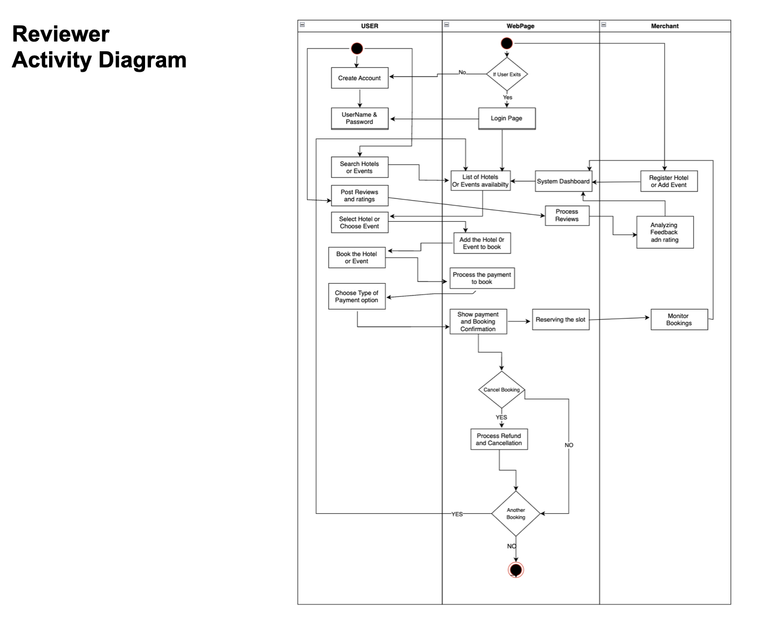
Activity Diagram - Kaushal
https://github.com/sanjeev-khannan/Reviewer/blob/main/Project%20Documents/Team4_ActivityDiagram_v3.pptx

Slide 11
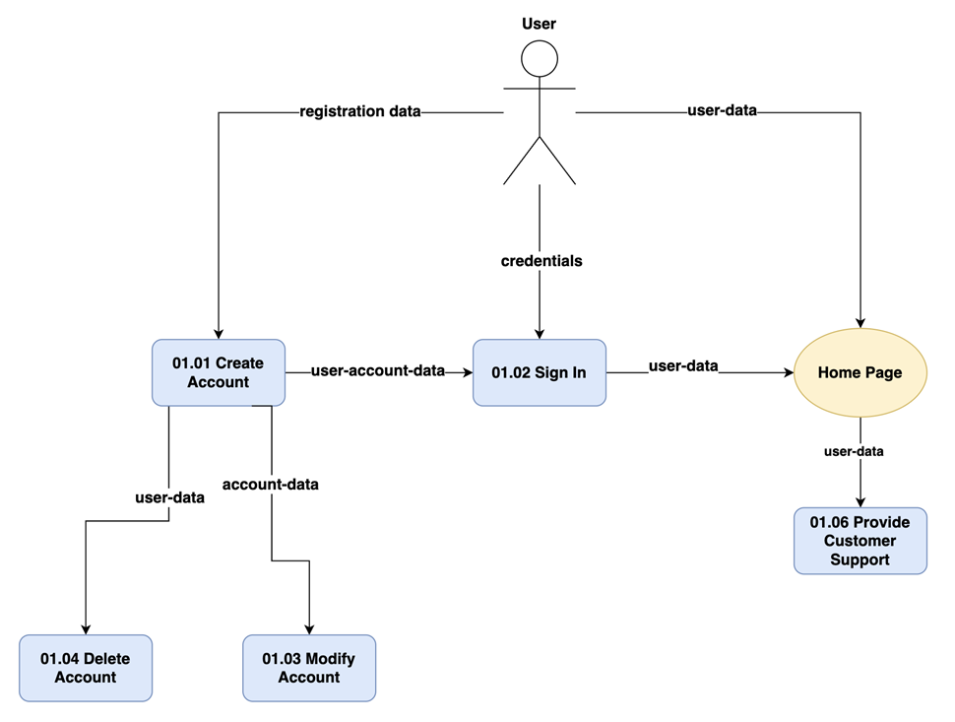
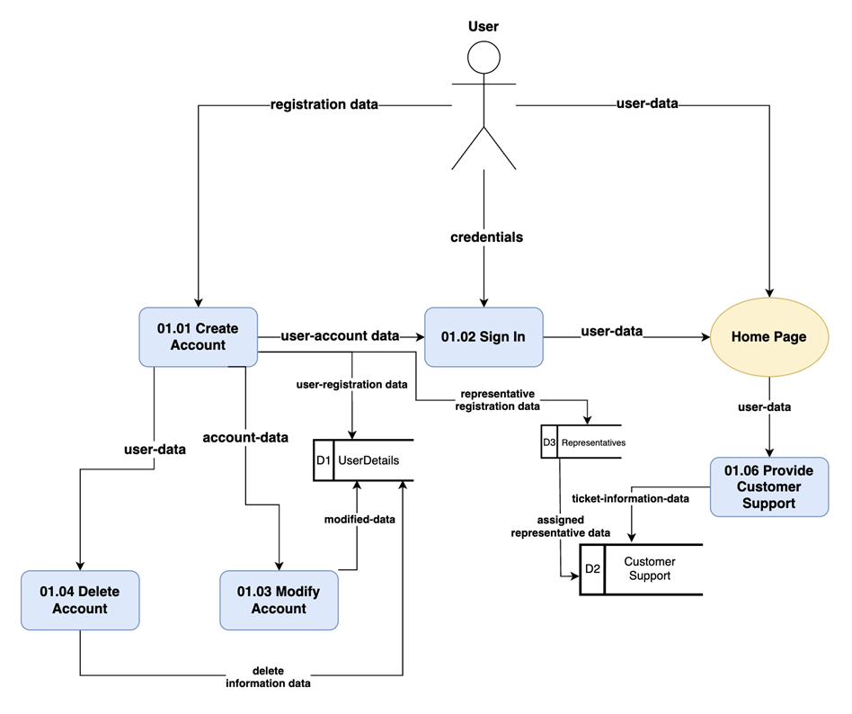
Data-Flow Diagrams- Logical, Physical - Vignan
https://github.com/sanjeev-khannan/Reviewer/blob/main/Project%20Documents/Team4_DataFlowDiagram_v2.pptx

Slide 12
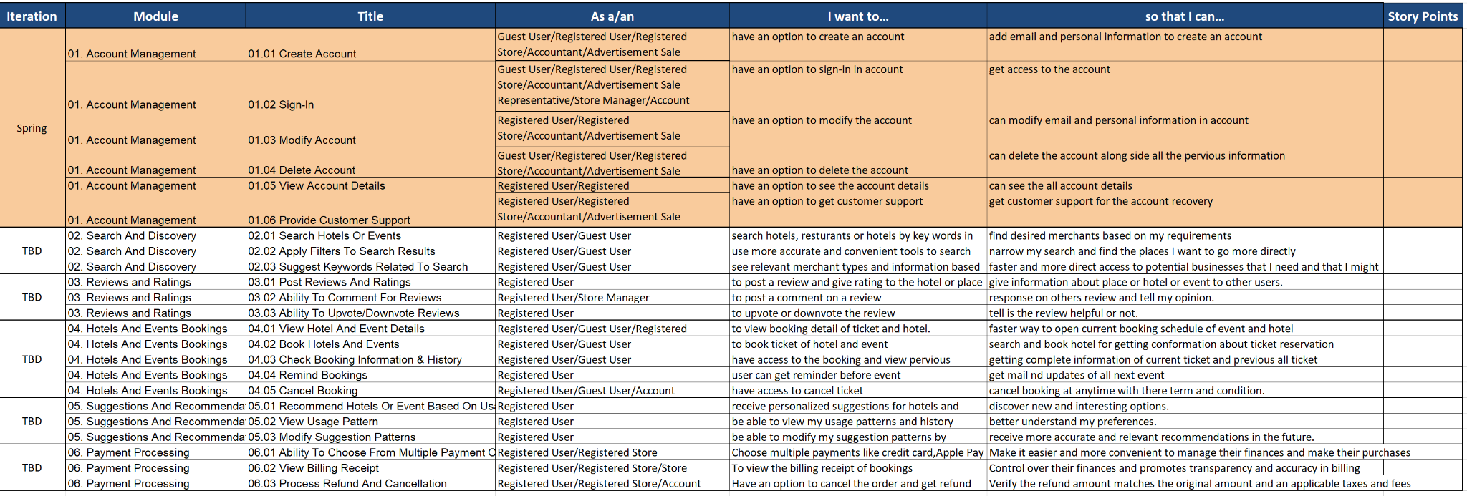
Functional Requirements(User Stories) - Nayan
https://github.com/sanjeev-khannan/Reviewer/blob/main/Project%20Documents/Team4_Functional%20Requirements_User%20Stories_v2.xlsx

Slide 13
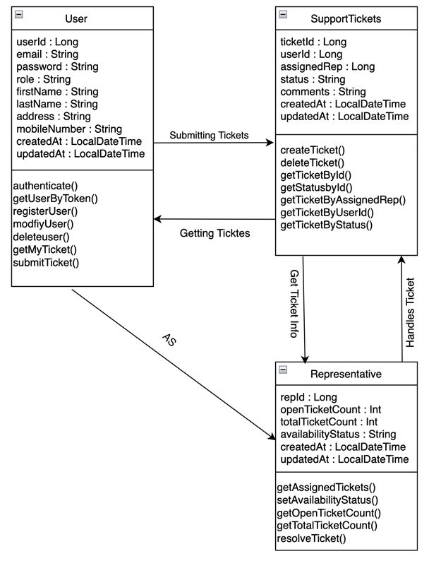
Class Diagrams - Vignan
https://github.com/sanjeev-khannan/Reviewer/blob/main/Project%20Documents/Team4_ClassDiagram_v2.pptx

Slide 14
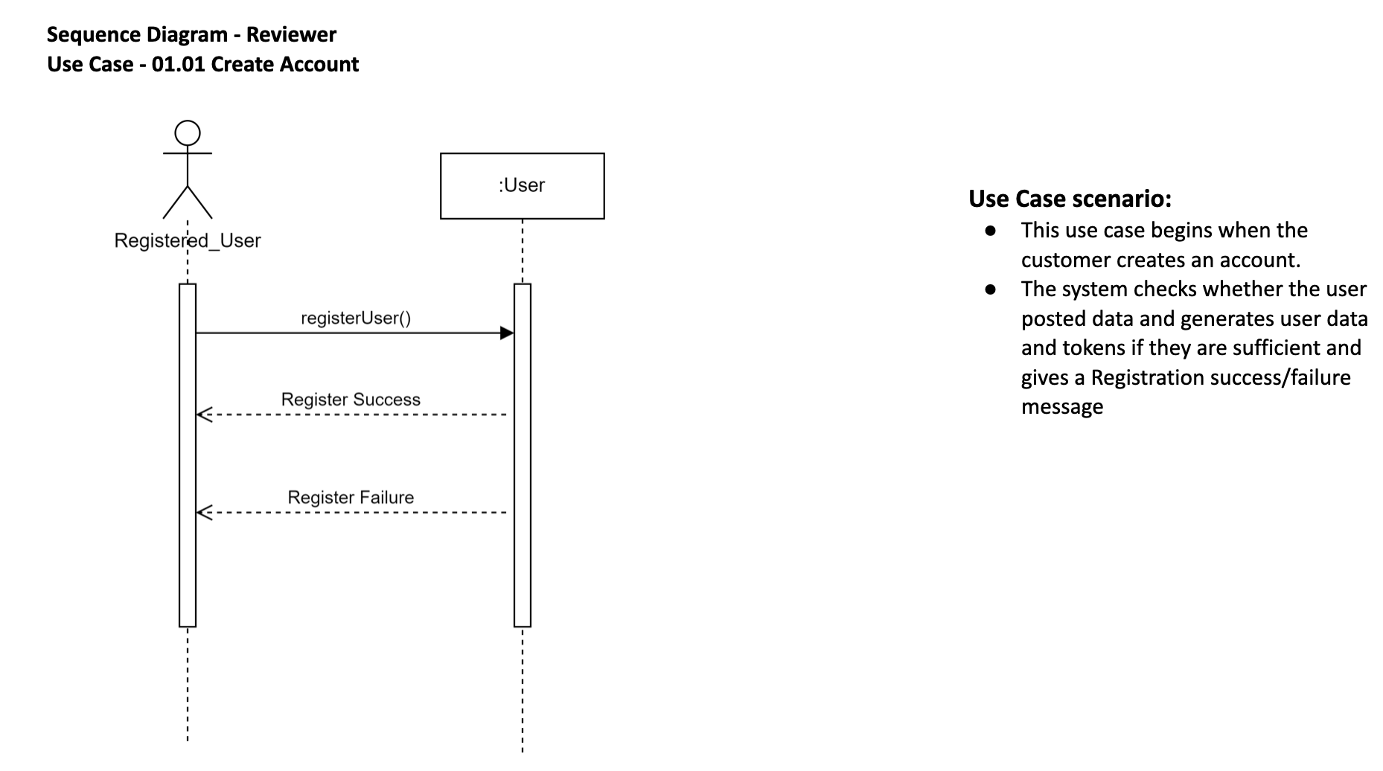
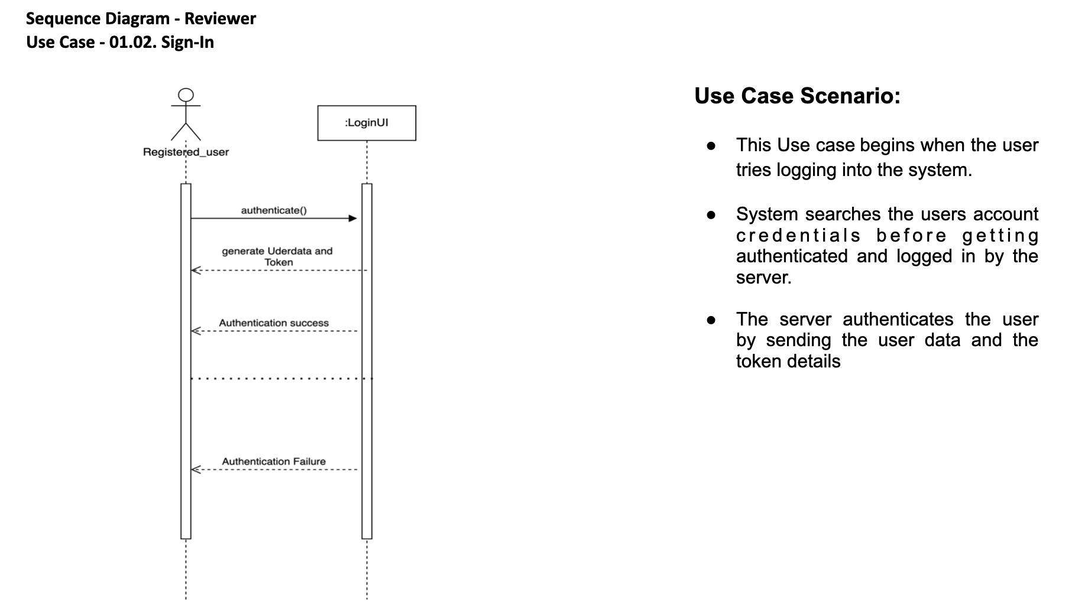
Sequence Diagram - Vignan
https://github.com/sanjeev-khannan/Reviewer/blob/main/Project%20Documents/Team4_SequenceDiagram_v4.pptx

Slide 15
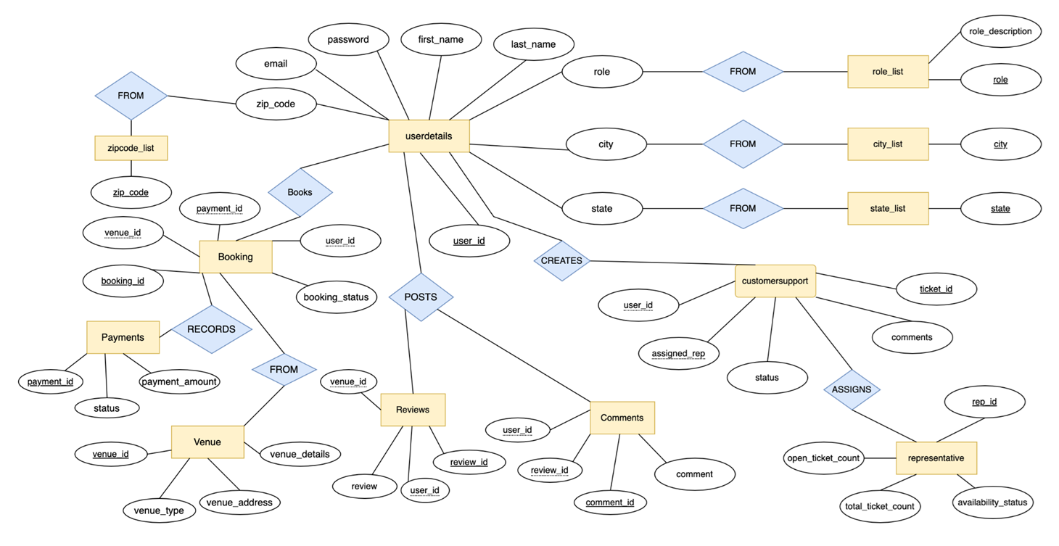
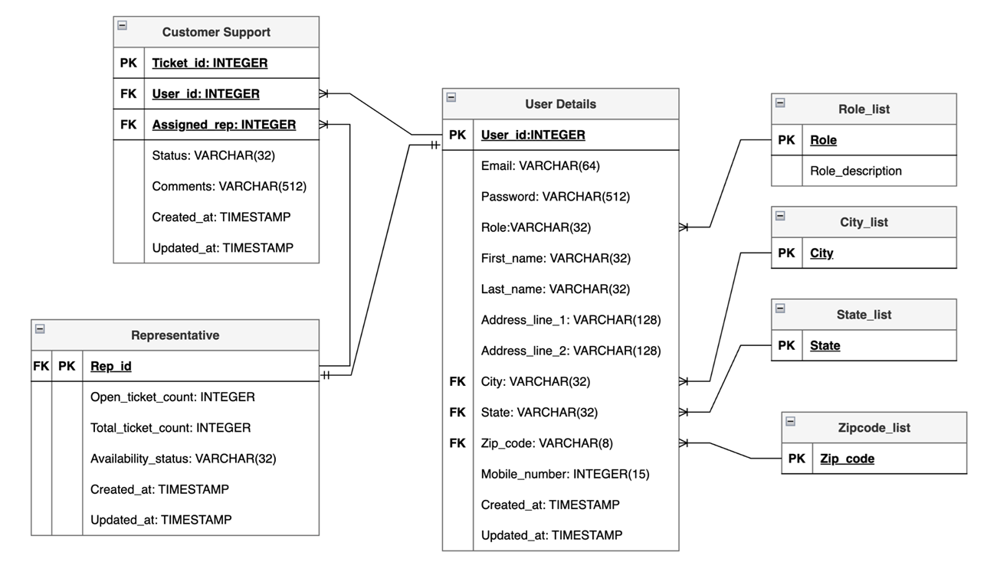
ER Diagram(Conceptual, Logical) - Vaibhav
https://github.com/sanjeev-khannan/Reviewer/blob/main/Project%20Documents/Team4_ERDiagrams_v3.pptx

Slide 16
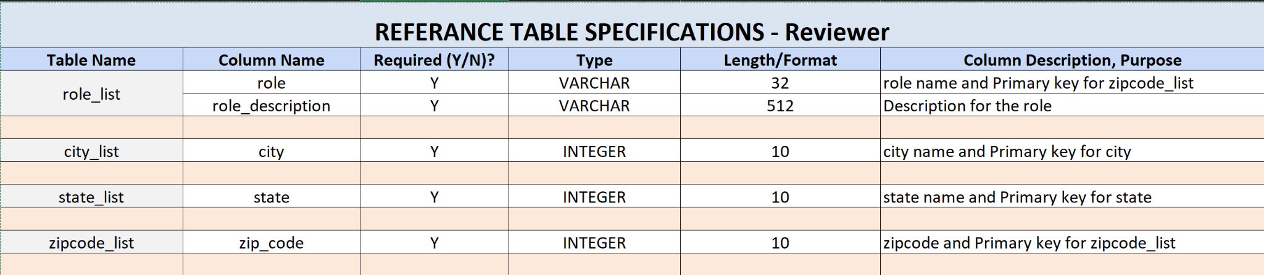
Table Specification - Kaushal
https://github.com/sanjeev-khannan/Reviewer/blob/main/Project%20Documents/Team4_ReferenceTableSpecifications_v1.xlsx

Slide 17
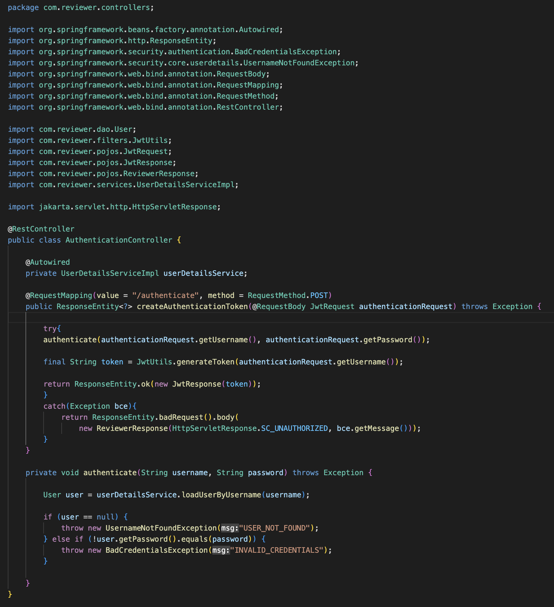
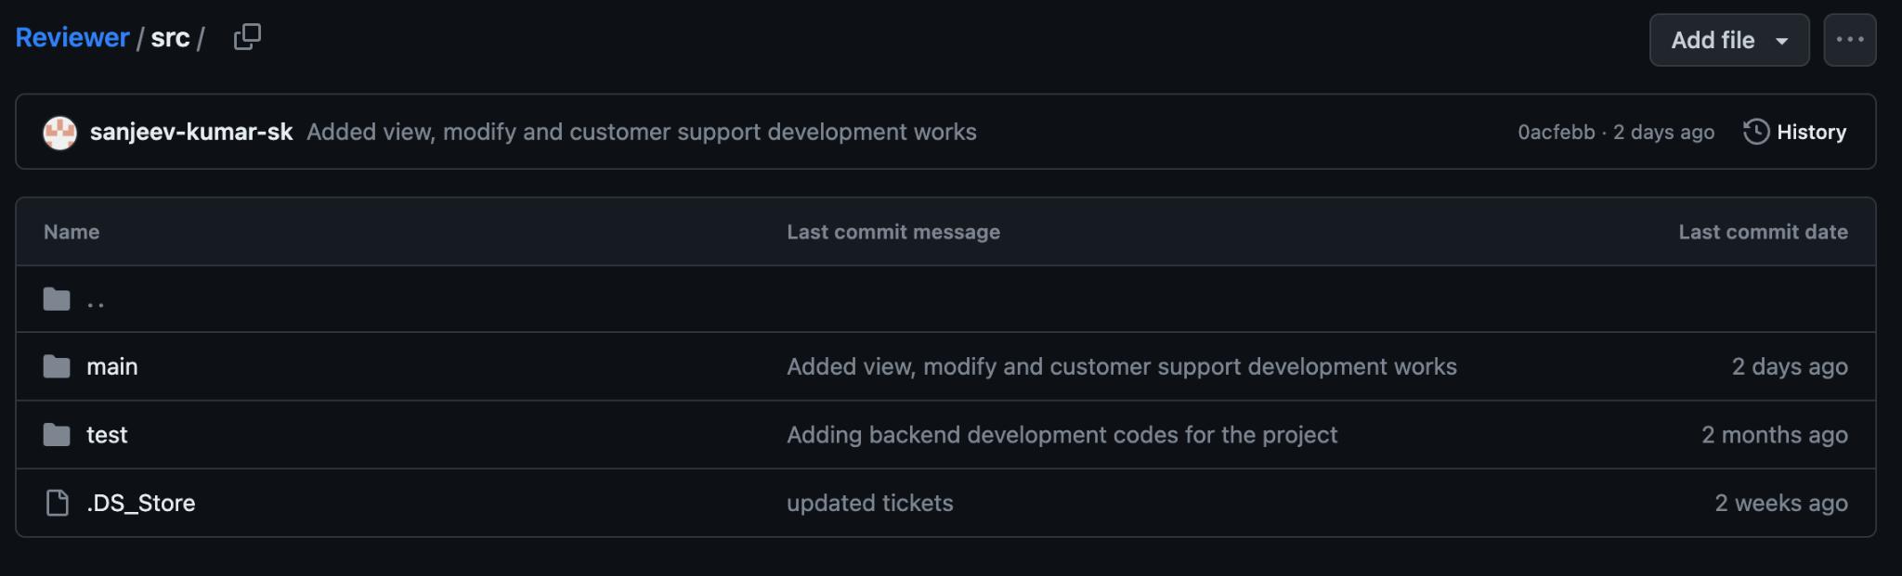
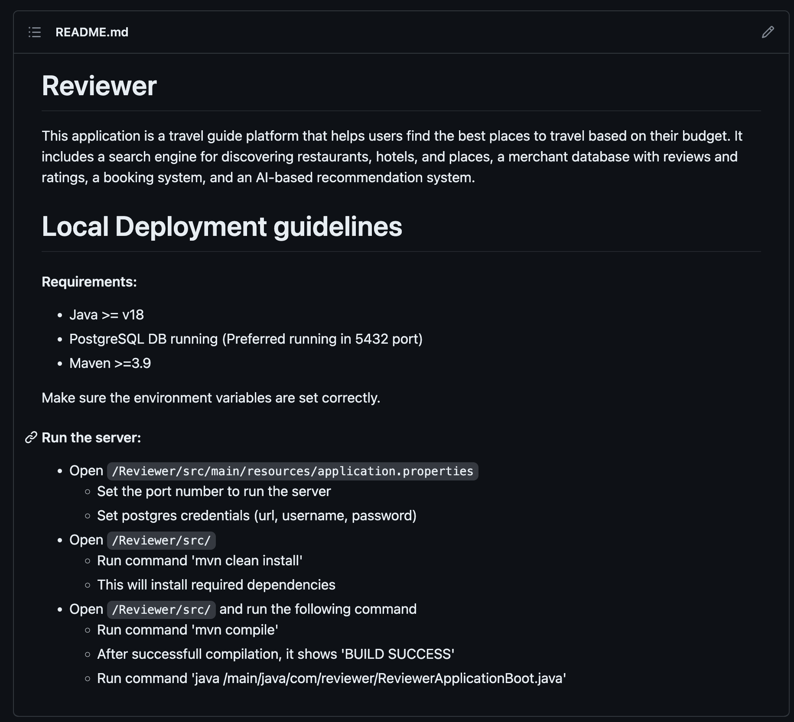
GitHub Repo - Sanjeev
https://github.com/sanjeev-khannan/Reviewer/blob/main/Project%20Documents/Team4_Reviewer_GitHub.pptx

Slide 18
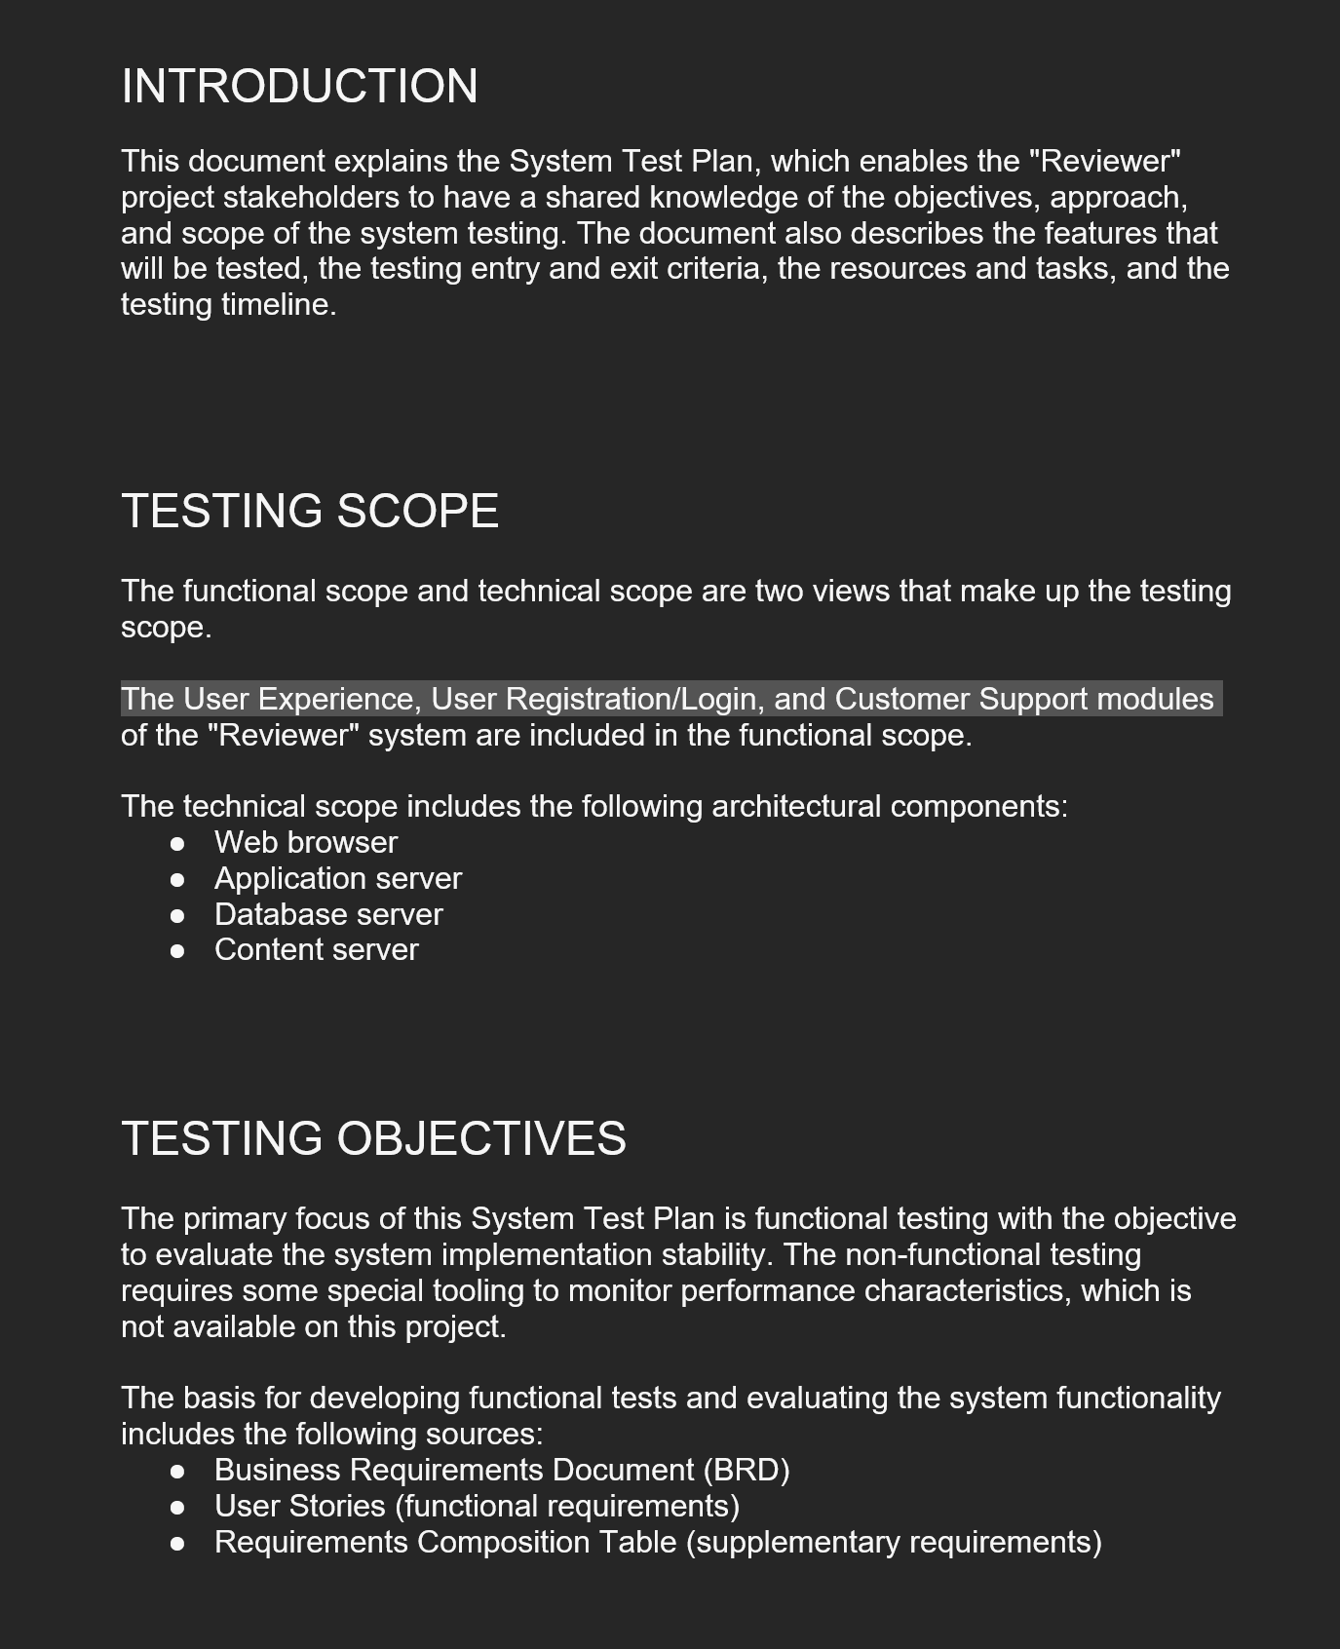
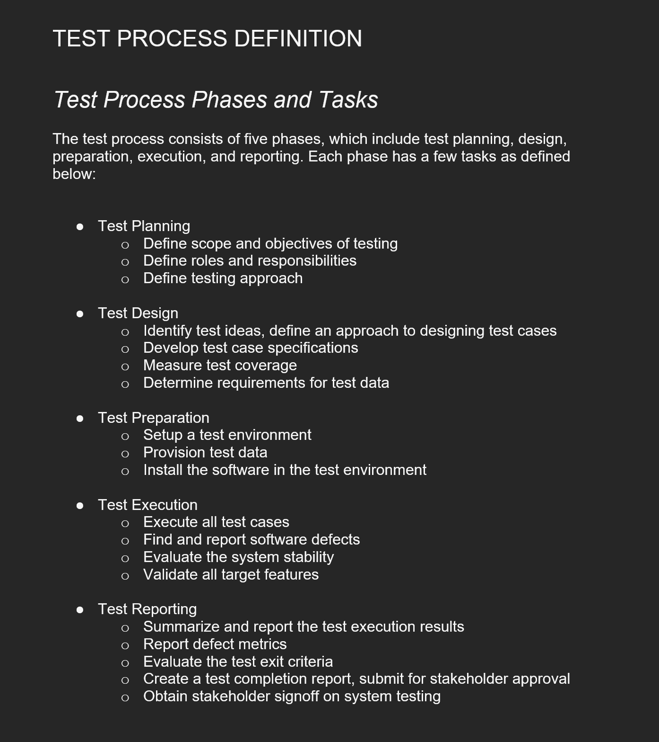
Test Plan - Kaushal
https://github.com/sanjeev-khannan/Reviewer/blob/main/Project%20Documents/Team4_TestPlan_v1.docx

Slide 19
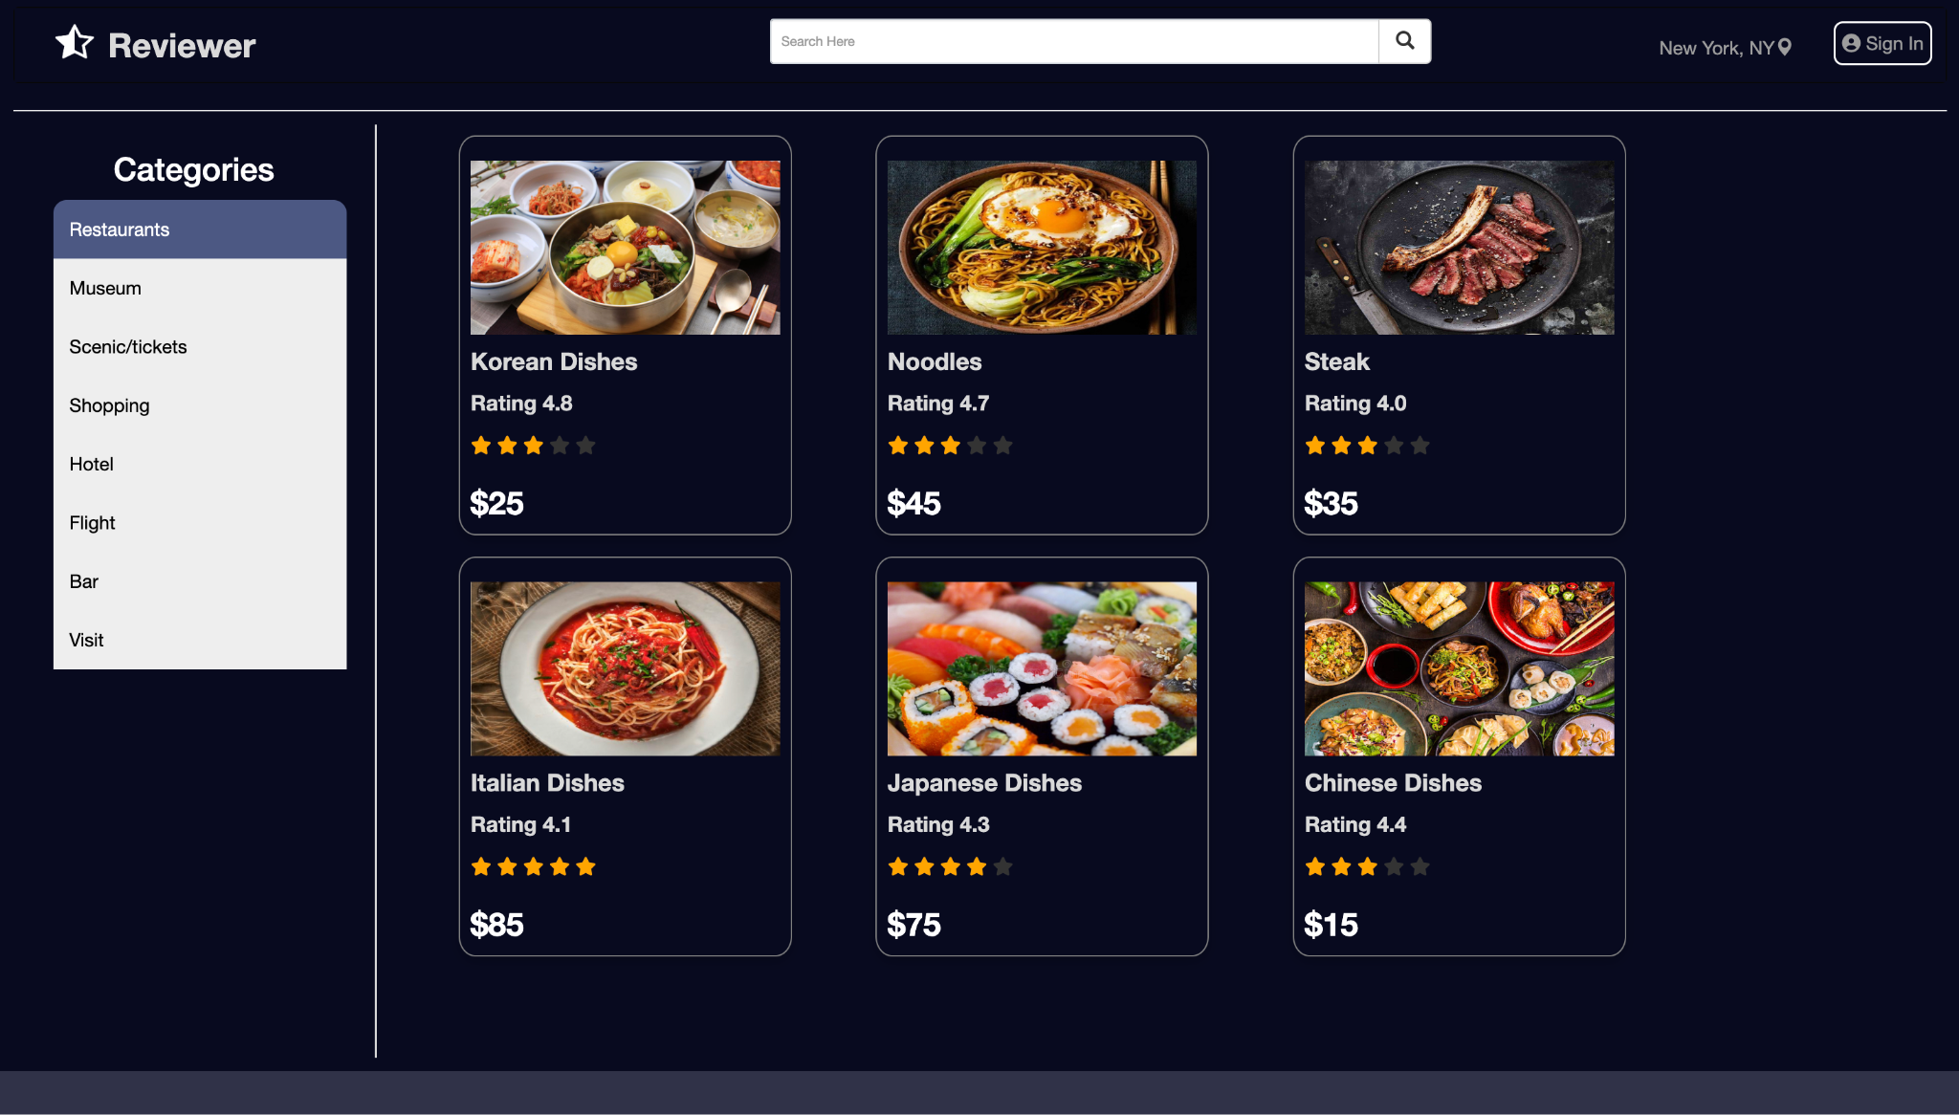
Application Demo - Sanjeev
https://github.com/sanjeev-khannan/Reviewer/blob/main/Final%20Documents/18.%20Application%20Demo.mov

